Slide 1
Generator Aggregation: Illustrative Examples
Blue and Green markers indicate generator buses
Yellow and Pink markers indicate generators
Using two different colors for each type just helped me during the assignment process; they have no other meanings

Slide 2
NPCC

Slide 3
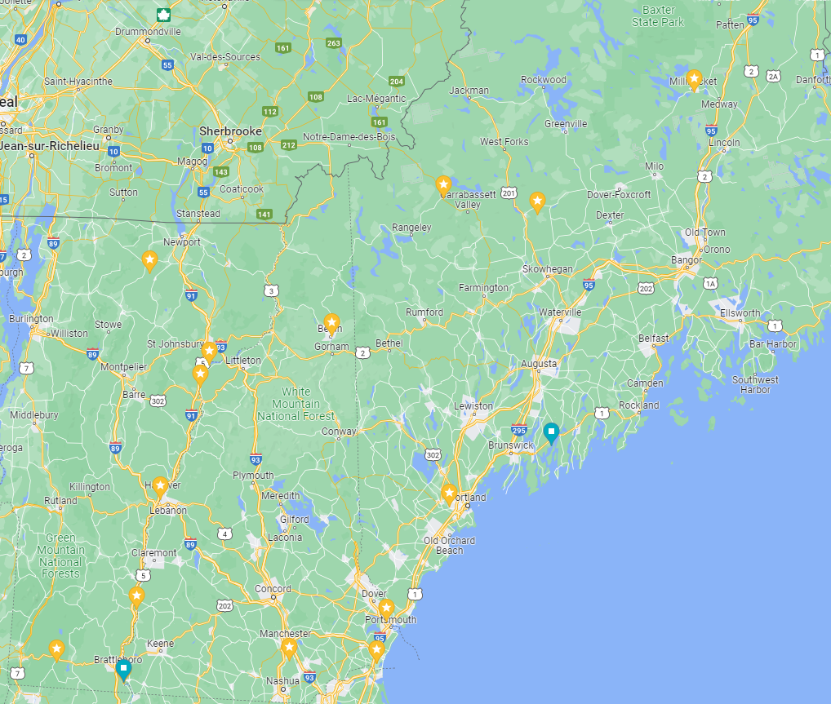
Vermont, New Hampshire, and Maine Generator Examples

Slide 4
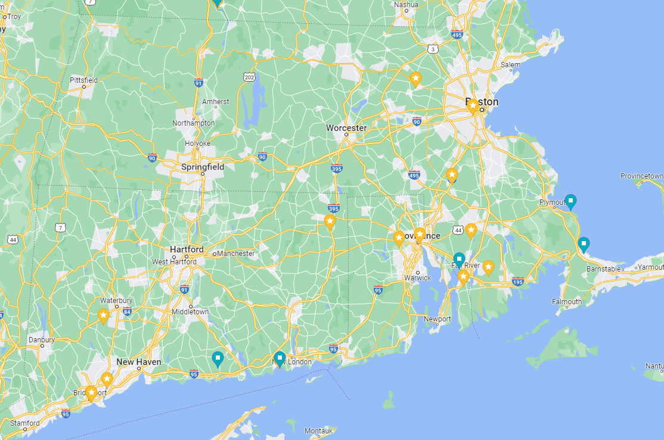
Massachusetts, Connecticut, and Rhode Island Generator Examples

Slide 5
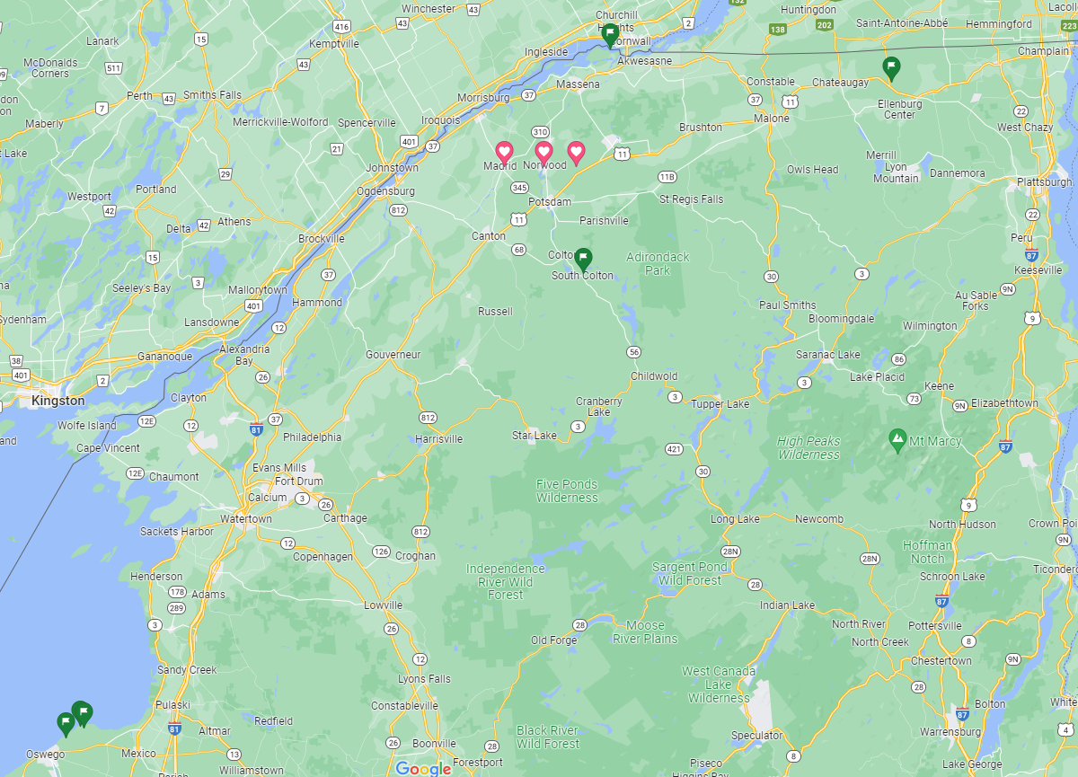
New York Generator Examples

Slide 6
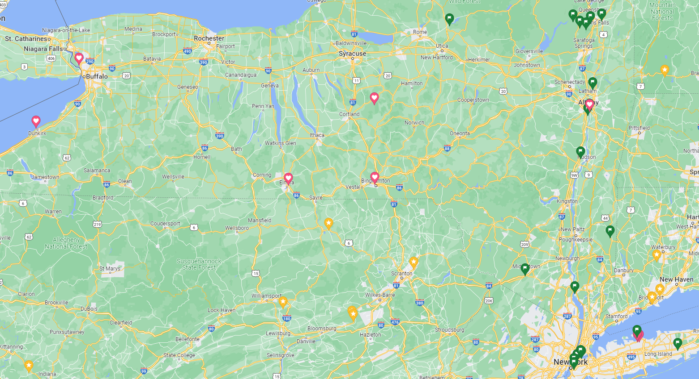
New York (cont.)

Slide 7
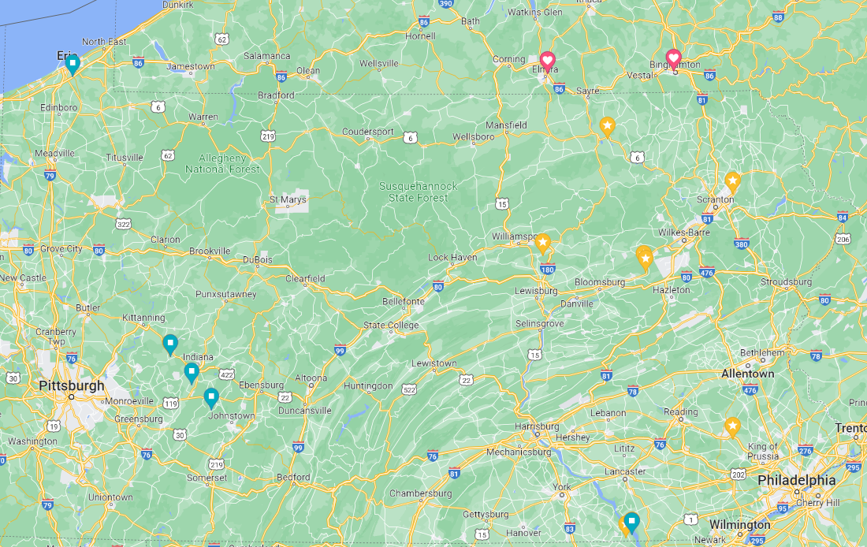
Pennsylvania Generator Examples

Slide 8
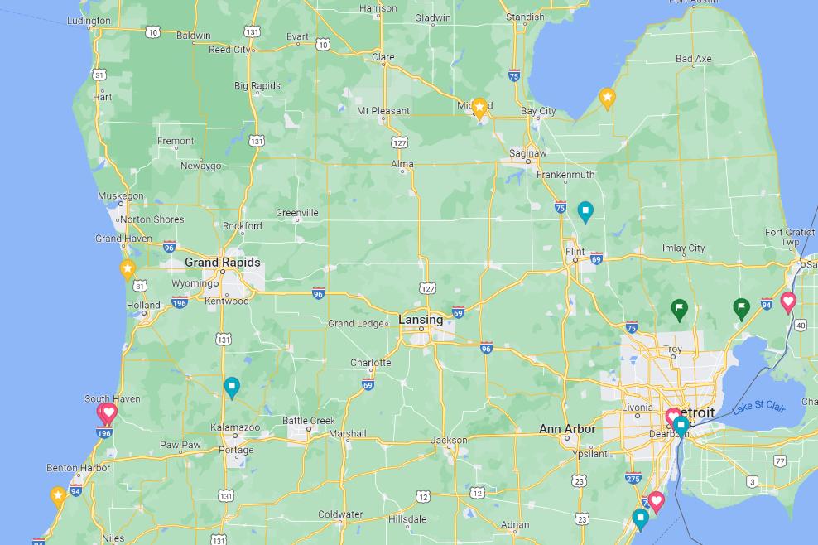
Michigan Generator Examples

Slide 9
WECC

Slide 10
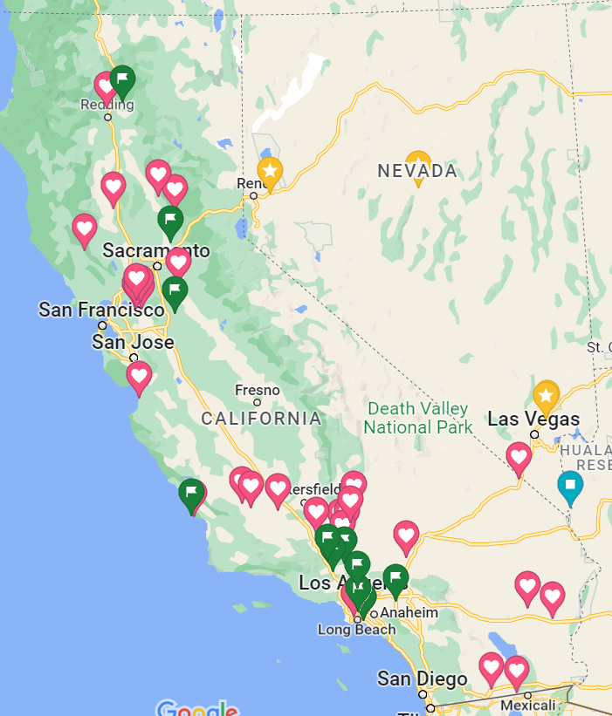
California and Nevada Generator Examples

Slide 11
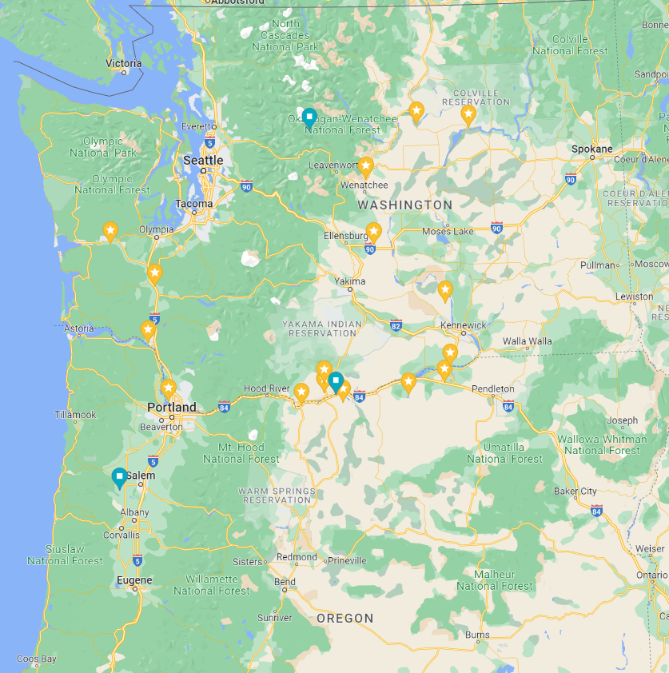
Washington and Oregon Generators

Slide 12
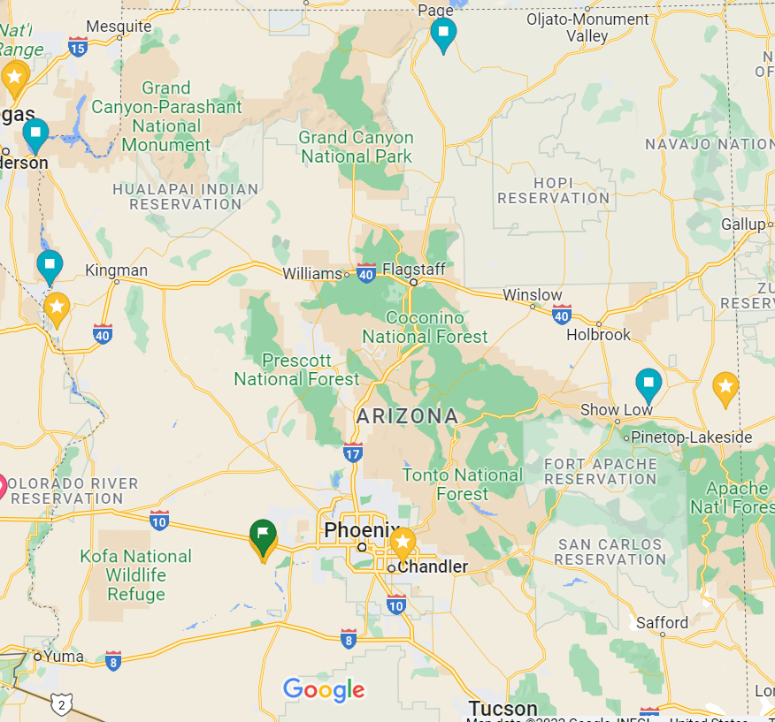
Arizona Generator Examples

Slide 13
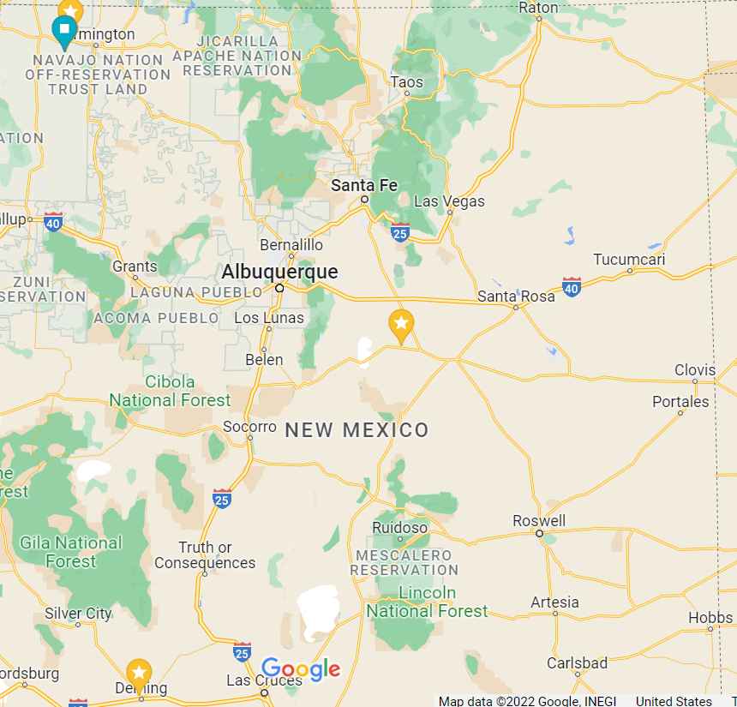
New Mexico Generator Examples

Slide 14
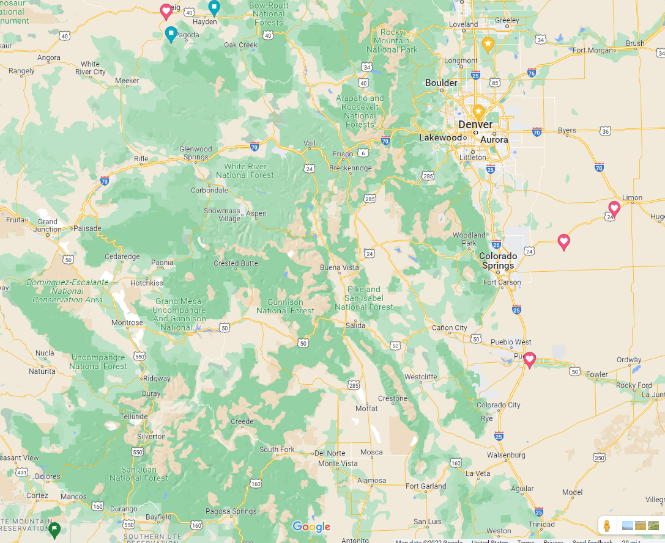
Colorado Generators

Slide 15
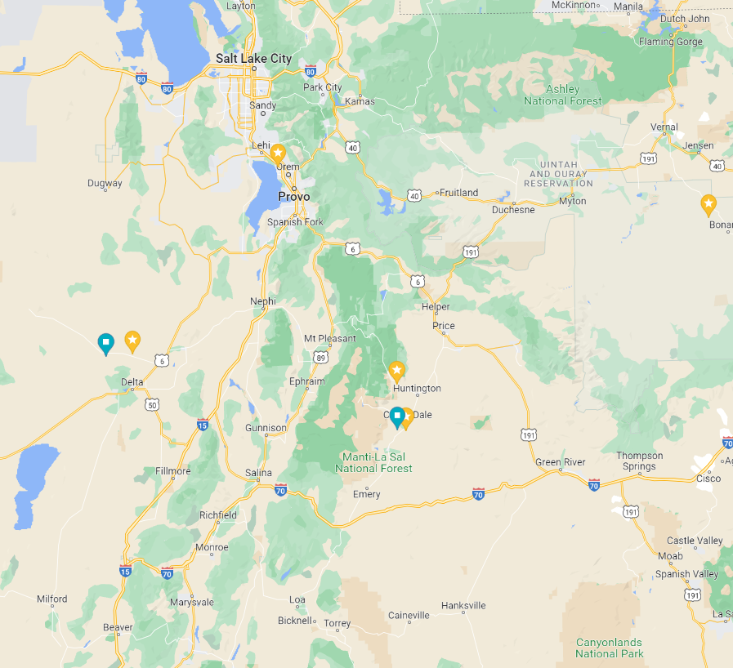
Utah Generator Examples

Slide 16
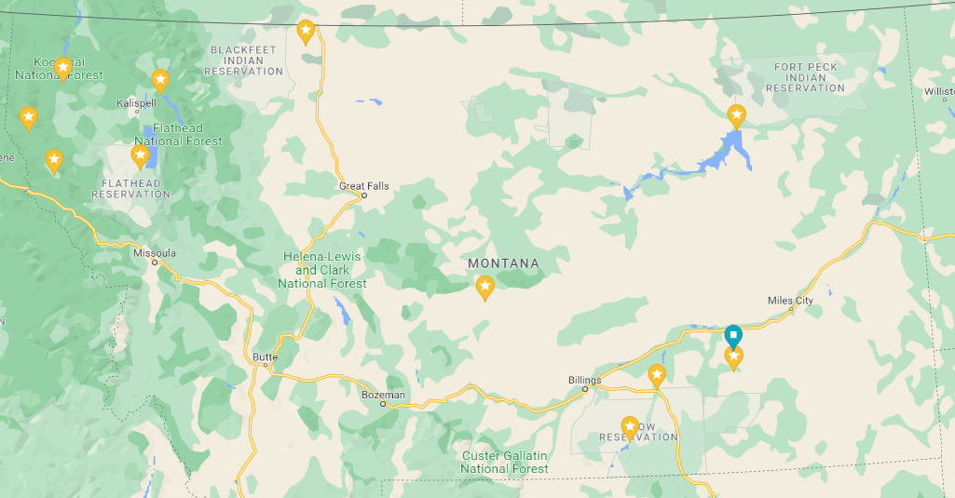
Montana Generator Examples

Slide 17
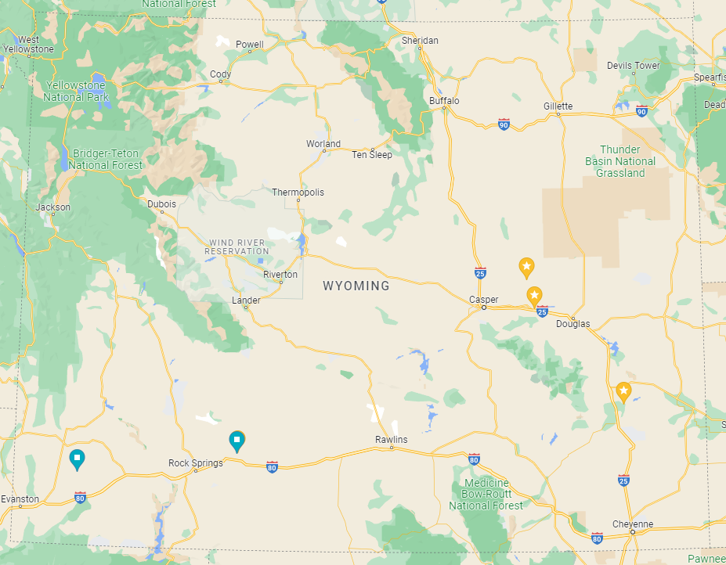
Wyoming Generator Examples

